Slide 1

Protected Python: It’s time we had “the talk” about cyber security
James Mertz

Slide 2

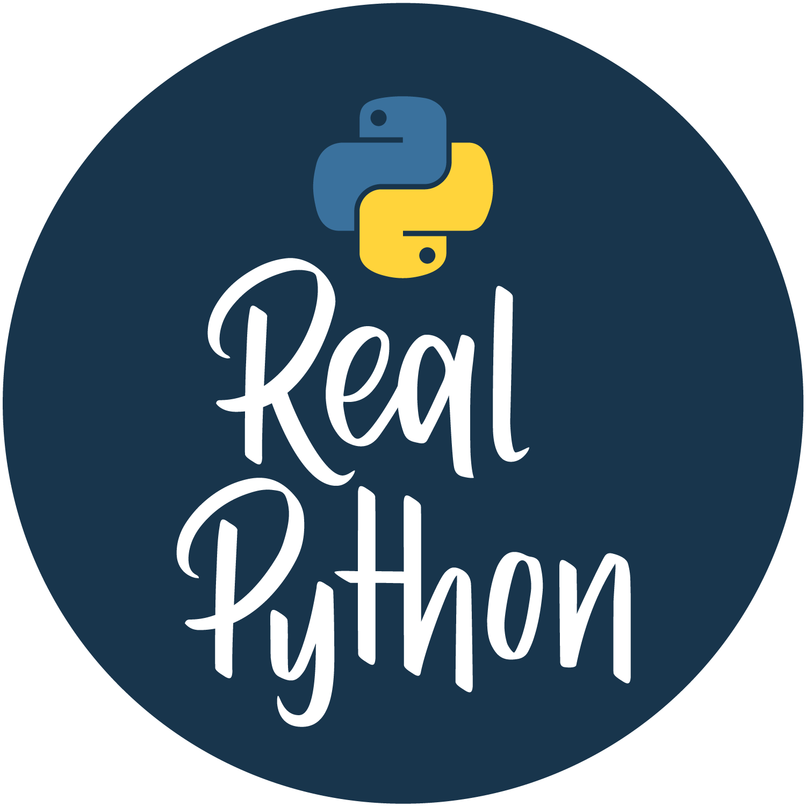

About Me
Software Quality Assurance Engineer at NASA’s Jet Propulsion Laboratory
Europa Clipper Project
Cybersecurity Assurance Project
Author for Real Python
Teacher at Pasadena City College
Intro to Programming (Python)
Working & Teaching Python ~10 years

Slide 3
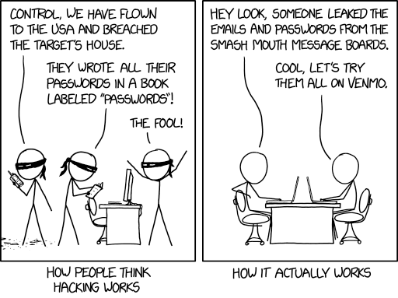
What Is Cyber Security?
https://xkcd.com/2176/

Slide 4
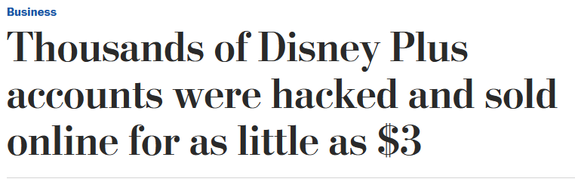
What Is Cyber Security?
https://www.washingtonpost.com/business/2019/11/19/thousands-disney-accounts-were-hacked-sold-online-little/

Slide 5
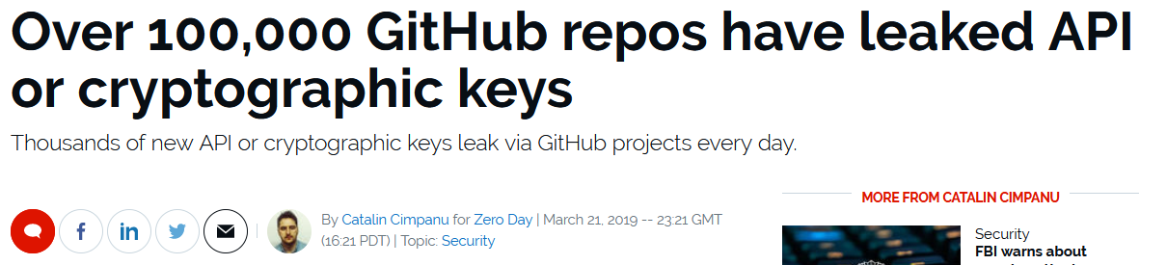
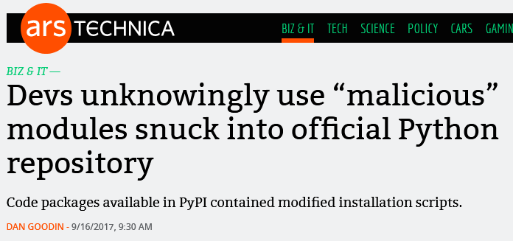
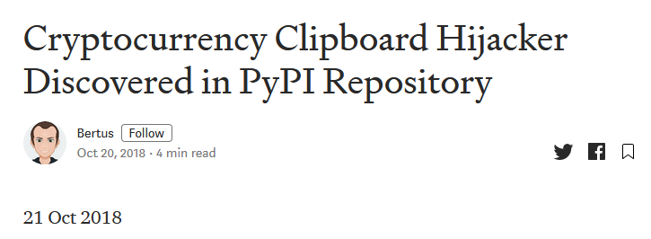
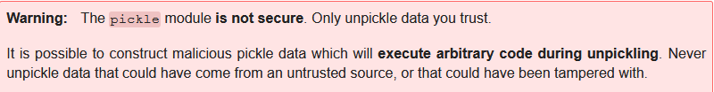
Why Should Python Developers and Users Care?

Slide 6
Cybersecurity is…
Messy
Complicated
Faked
Time Consuming
Awkward

Slide 7
Cybersecurity is…
Nobody wants to
talk about it…
But
Everybody Says
They’re “Doing It”

Slide 8
The first step to having good cybersecurity…
Honest & Open
Communication

Slide 9
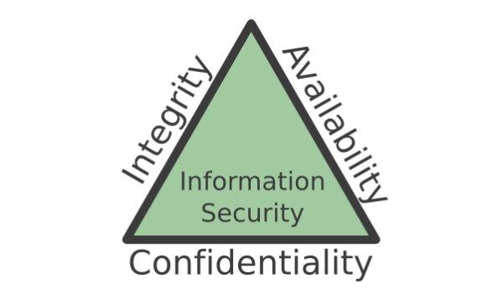
Formal Definition of Cybersecurity
“Measures and controls that ensure confidentiality, integrity, and availability of information system assets including hardware, software, firmware, and information being processed, stored, and communicated.” (Stallings 2)
CIA Triad:
Confidentiality
Integrity
Availability
This Photo by Unknown Author is licensed under CC BY-SA
Notes:
Confidentiality – What is meant to be kept secret, stays secret.
Integrity – What is being presented to your users is complete and accurate.
Availability – Your services are available to your users when needed.

Slide 10

Defense Strategies
Tower Defense (Old Strategy)
Protect everything that is assaulting you from the outside
Not paying attention to the stuff on the inside

Slide 11

Defense Strategies
Tower Defense (Old Strategy)
Protect everything that is assaulting you from the outside
Not paying attention to the stuff on the inside
Defense in Depth
Tower Defense with a mixture of Clue

Slide 12
Common Attack Vectors and How To Protect

Slide 13

Little Bobby Tables
https://www.xkcd.com/327/

Slide 14


Web Applications
Untrusted Data
If the data ever leaves your hands, it’s “Untrusted”
SQL Injection
File/Data uploads
Messaging
Cross-Site Scripting (XSS)
Injection of malicious code into the users browser
Cross-Site Request Forgery (CSRF)
“Tricking” the user into unauthorized access of your site
Sanitize your data
Use crypto safe libraries (Don’t create your own!)
Use built-in tools and recommendations for web frameworks
https://docs.djangoproject.com/en/3.0/topics/security/
https://flask.palletsprojects.com/en/1.1.x/security/?highlight=security
Use SSL whenever possible

Slide 15
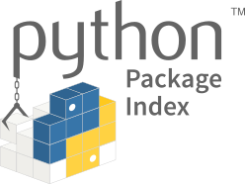
Developer Environments
Untrusted Data
Loading
Executing
Malicious 3rd Party Packages (Typo-squatting)
Avoid using pickle or yaml for de-serializing data
Use json instead
Use defusedxml for xml parsing to avoid XML bombs
Avoid using exec or subprocess.call( shell=True) for execution of code/outside process calls
Always check the package name you’re about to install
When in doubt, look at the source!
Consider using Anaconda and their official package repo for package management
PyPi is looking at securing packages better as well:
https://github.com/pypa/warehouse/milestone/16
“Bringing Two Factor Authentication to PyPI” by William Woodruff

Slide 16
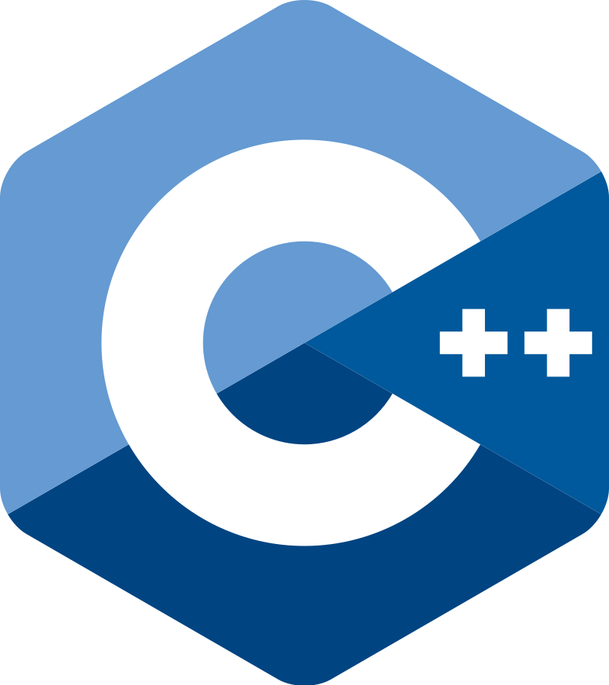

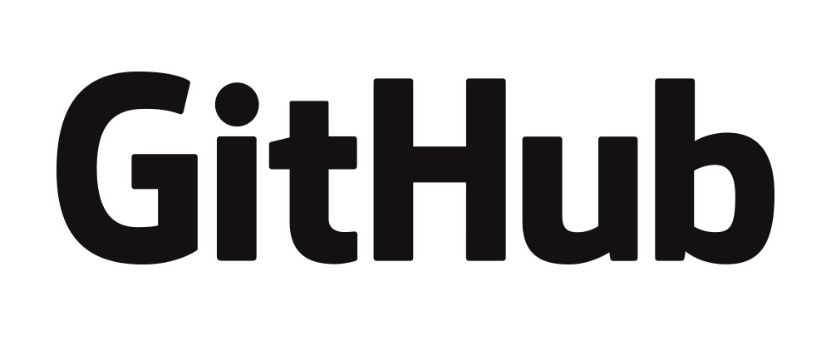
Code Base and Repositories
Data spillage
Outdated package dependencies
Improper 3rd Party Package Usage
Did you know that numpy uses pickle in certain cases?
Using C extensions
Don’t place keys, passwords, tokens, etc, into your repository
Don’t fall into the trap of “I’ll just .gitignore this file”
Use environment variables instead
Keep your requirements.txt (and dev env) up to date with 3rd party package updates
Read the documentation for security warnings
Pay special attention to C extensions and its exploits
Buffer/stack overflows
Use Static Analysis on your custom C extensions

Slide 17





Security Tools/Resources
Bandit
Security Scanner with ability to create custom tests
PyUp
Scans requirements.txt and makes sure packages are up to date
Python Security PyCharm add-in
Security checks
OWASP Top 10
A list of the top 10 security risks for applications
Mitre’s Common Vulnerability and Exposures
A collection of the most common vulnerabilities
SANS Institute
Technical Training and Papers

Slide 18
Final Thoughts
Awareness is key
Seek out help
And…
Notes:
Talk about looking at the security awareness of the project
environments
C static analysis

Slide 19
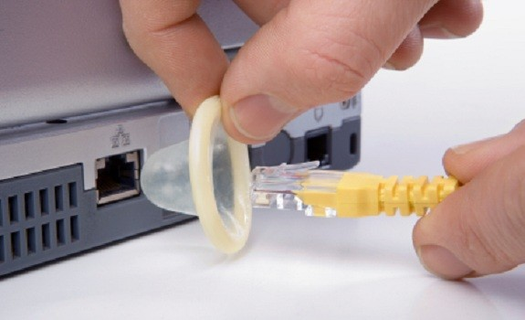
Always Use Protection
Notes:
Talk about looking at the security awareness of the project
environments
C static analysis

Slide 20
References
Stallings, William, Lawrie Brown. Computer Security, 4th Ed
Wikipedia. Information Security.
Digging for Security Bugs in Python by Travis McPeak
10 common security gotchas in Python and how to avoid them by Anthony Shaw
Advanced Security Topics, PyCon 2012 by Paul McMullin
Python Security Best Practices Cheat Sheet by synk

